Slide 1

Near-field Scanning Optical Microscopy (NSOM) for Integrated photonic devices
Integrated Photonics course (377.2.5599) presentation
on
Presented By:
Ankit Chauhan
(student Id. 850306036)
Date: 3rd January 2021

Slide 2
Key point to discuss…..
General background
Why we need Near-field?
Near field scanning optical microscopy (NSOM)
Introduction
Theoretical background
Schematic and working principle
NSOM application and analysis
Limitations

Slide 3
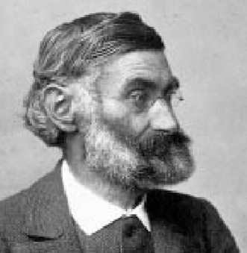
Theory: Optical resolution is limited
Ernst Abbe, 1873
Resolution is diffraction limited.
Abbe (1873) reported that smallest resolvable distance between two points (d) using a conventional microscope may never be smaller than half the wavelength of the imaging light (~200 nm)
500 nm
Methods that are based on lenses have limited spatial resolution
200 nm

Slide 4
Numerical Aperture & Resolution
The numerical aperture (NA) is one of the most important parameters of an optical microscope.
It determines:
The amount of collected light
The optical resolution
But where does it originate?
2a
z

Slide 5
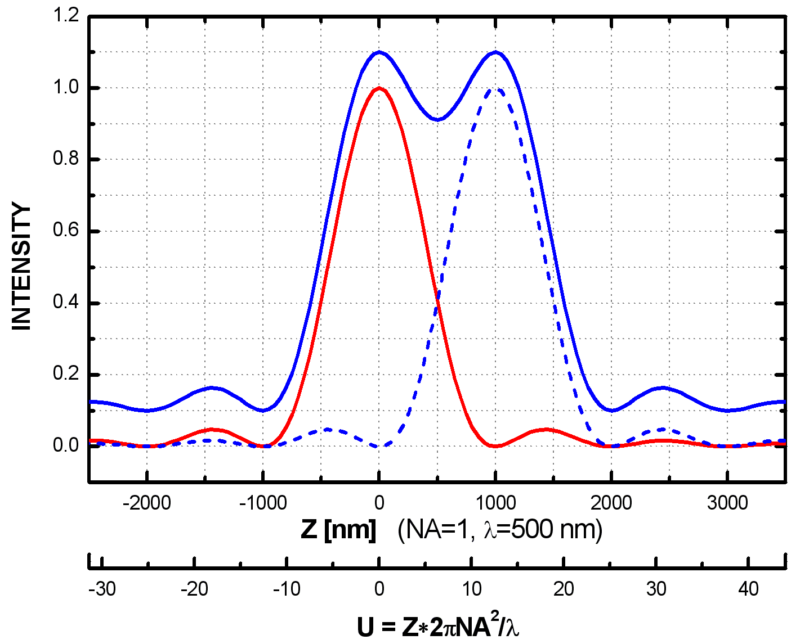
Typical Values
A round aperture produces an airy disk on the screen
The size of the airy disk(s) depends on the NA and λ
Rayleigh criterion says resolution is:
R [nm] with NA = 0.3, λ = 500 nm

Slide 6
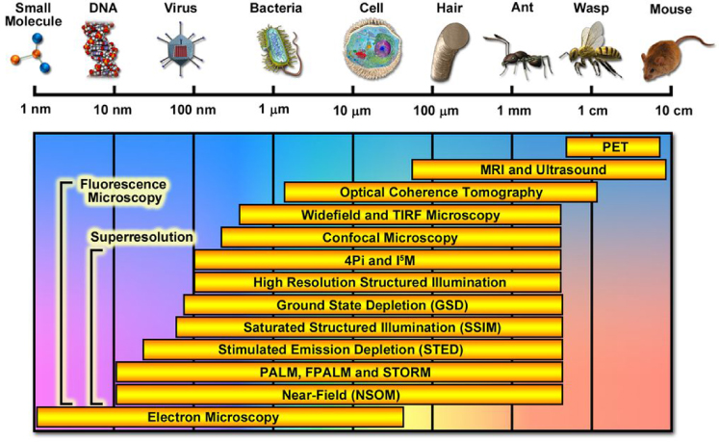
Spatial Resolution of Imaging Techniques
Ref:- Allen, J.R., Ross, S.T. and Davidson, M.W., 2013. Single molecule localization microscopy for super resolution. Journal of Optics, 15(9), p.094001.
Notes:
http://zeiss-campus.magnet.fsu.edu/articles/superresolution/introduction.html

Slide 7


How can we overcome the diffraction limit??
Completely different approach:
Break the diffraction limit by working in the near-field
$$N_{f}=\frac{a^{2}}{Lλ}$$
NEAR FIELD
Fresnel No. :
Illuminated “spot” is smaller than diffraction limit
(about the size of the tip for a distance equivalent to tip diameter)
~50 nm
High intensity
Low intensity
Measure VERY CLOSE to tip ~10 nm

Slide 8
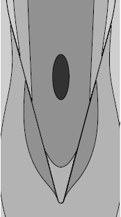
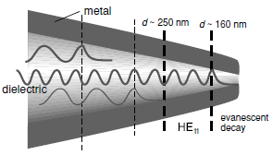
Key factor: NSOM probe
NSOM Probes type
Aperture type
  Metal coated probe
  Uncoated /dielectric probe
(b)
(a)
Fabrication of NSOM Probes
Tapering
Chemical etching
Heating and pulling
Molding
Metal coating
Dielectric aperture probe
Metal coated aperture probe
High transmission efficiency
Less backscattered noise
Leakage from side wall
Evanescent as well as plane
waves
Prevent field from leakage
High light confinement
Evanescent waves only
Heating effect
High noise
Advantage
Disadvantage
Ref: Novotny, L. Principle of Nano Optics. Cambridge 6, (2006)
Notes:
Choosing an appropriate shape design for the apertures, such as C-shaped or bow-tie, can lead to substantial enhancements in the power throughput. For C-shaped apertures the light is localized on the ridge at the exit surface of the aperture, and provides a very strong near-field. Using such structures, an enhancement of power throughput of up to two or three orders of magnitude higher than square apertures is achievable. (Cheng et al ., 2011).

Slide 9
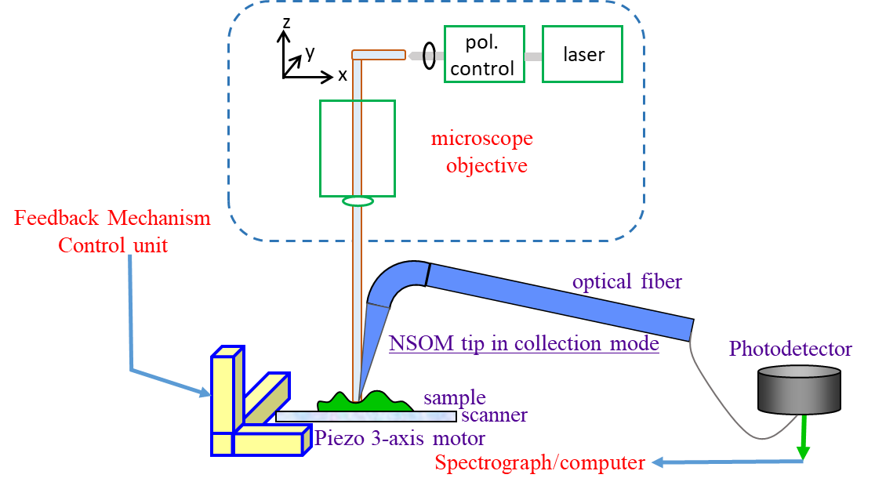
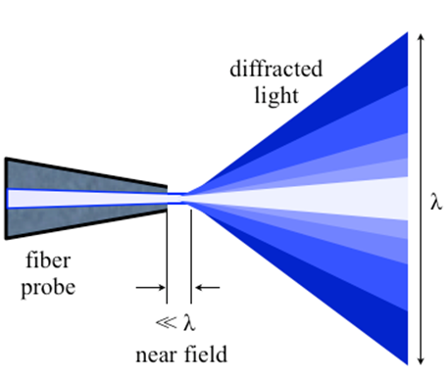


NSOM working principle
In 1928-32, Edward Hutchinson Synge gave idea of near field
In 1993, Eric Betzig and Robert Chichester used NSOM for repetitive single molecule imaging
Near-field near surface of object, < λ of light
Aperture diameter less than the wavelength of light
Near-field consists of light as evanescent wave
Decay constant is given by:-
Evanescent waves has higher frequency, more information
$$γ=k_{2}\sqrt{{{\tilde{n}}^{2}sin}^{2}θ_{1}−1}$$
NSOM is a form of scanning probe microscopy
NSOM offers high resolution around 50 nm
Breaks the far field resolution limit by exploiting the properties of evanescent waves
These fields carry the high frequency spatial information about the object.
light through small aperture
Ref:- https://en.wikipedia.org/wiki/Near-field_scanning_optical_microscope

Slide 10
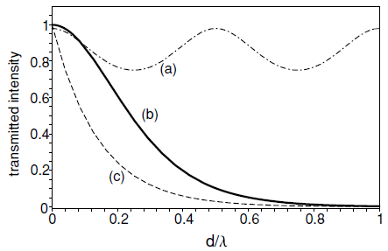







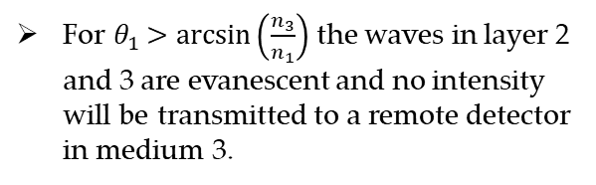

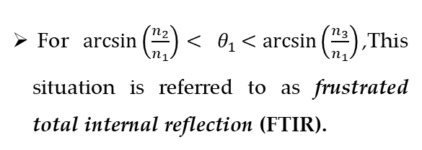




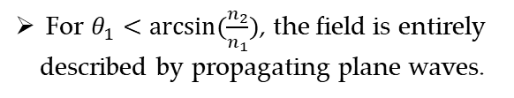






Theoretical background
$$n_{2}$$
$${<n}_{3}$$
$$<n_{1}$$
For $θ_{1}<arcsin⁡(\frac{n_{2}}{n_{1}})$, the field is entirely described by propagating plane waves.
Z
(1)
$$n_{3}$$
$$E_{3}^{\left(P\right)}$$
(2)
$$E_{3}^{\left(s\right)}$$
$$θ_{3}$$
A
For $\arcsin\left(\frac{n_{2}}{n_{1}}\right)<$ $θ_{1}<arcsin\left(\frac{n_{3}}{n_{1}}\right)$,This situation is referred to as frustrated total internal reflection (FTIR).
$$ε_{3}, μ_{3}$$
$E_{2}^{(P)}$
$ε_{2}, μ_{2}$
$$θ_{2}$$
d
B
$E_{2}^{(s)}$
$$n_{2}$$
x
$$E_{1}^{\left(P\right)}$$
$$θ_{1}$$
$$E_{1}^{\left(s\right)}$$
$$n_{1}$$
For $θ_{1}>arcsin\left(\frac{n_{3}}{n_{1}}\right)$ the waves in layer 2 and 3 are evanescent and no intensity will be transmitted to a remote detector in medium 3.
$$ε_{1}, μ_{1}$$
Fig.1 :Transmission of a plane wave through a system of two parallel interfaces.
Ref: Novotny, L. Principle of Nano Optics. Cambridge 6, (2006)

Slide 11
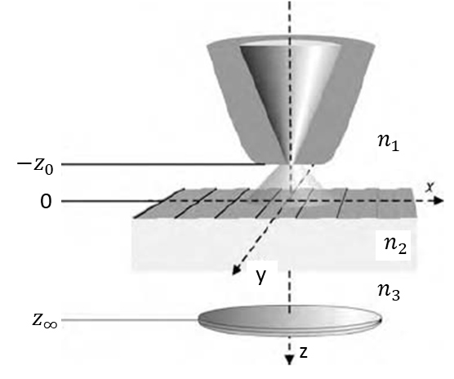
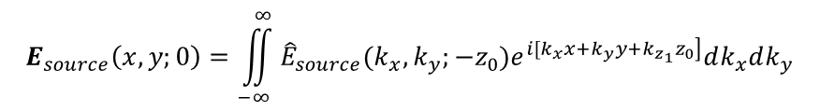
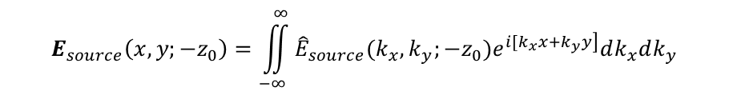
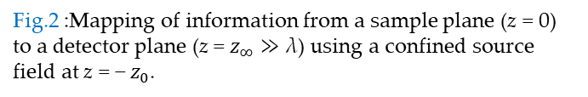
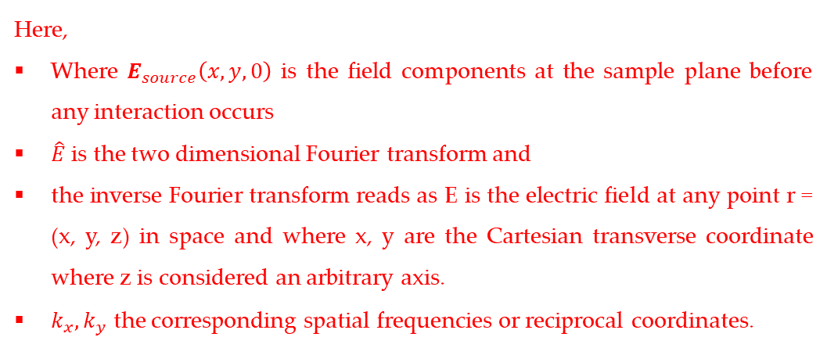
Theoretical background : propagation of near field to far-field
We consider three different planes: (1) source plane at z = -z₀, (2) the sample plane at z = 0, and (3) the detection plane at z = z∞.
The sample plane z = 0 forms the boundary between two different media characterized by indices n₁ and n₂, respectively.
The source field in terms of spatial spectrum is described as:
At source plane:-
$$E_{source}\left(x,y;−z_{0}\right)=\iint_{−∞}^{∞}{{\hat{E}}_{source}(k_{x},k_{y};−z_{0})e^{\left.i[k_{x}x+k_{y}y\right]}dk_{x}dk_{y}}$$
$$E_{source}\left(x,y;0\right)=\iint_{−∞}^{∞}{{\hat{E}}_{source}(k_{x},k_{y};−z_{0})e^{\left.i[k_{x}x+k_{y}y+k_{z_{1}}z_{0}\right]}dk_{x}dk_{y}}$$
Here,
Where $E_{source}\left(x,y,0\right)$ is the field components at the sample plane before any interaction occurs
$\hat{E}$ is the two dimensional Fourier transform and
the inverse Fourier transform reads as E is the electric field at any point r = (x, y, z) in space and where x, y are the Cartesian transverse coordinate where z is considered an arbitrary axis.
$k_{x},k_{y}$ the corresponding spatial frequencies or reciprocal coordinates.
Fig.2 :Mapping of information from a sample plane (z = 0) to a detector plane (z = $z_{∞}≫$ λ) using a confined source field at z = − $z_{0}$.
Continue…..

Slide 12
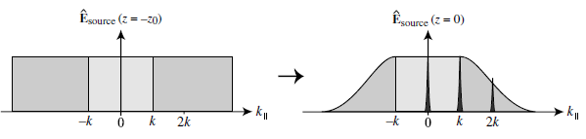
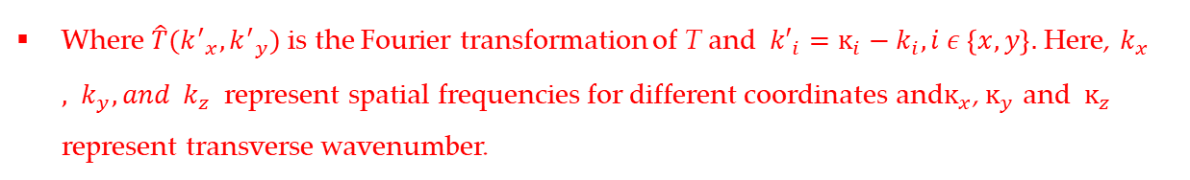
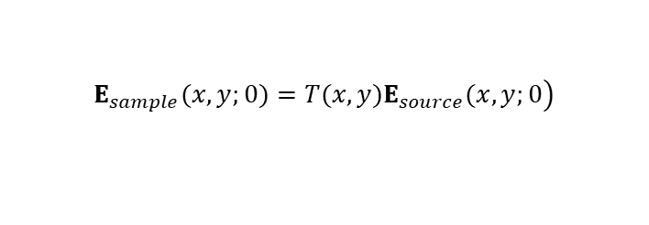
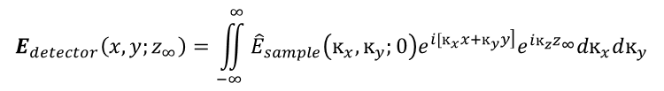
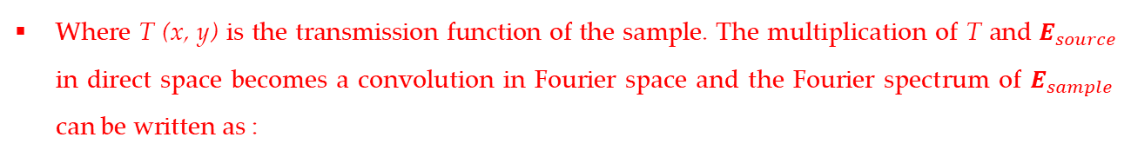
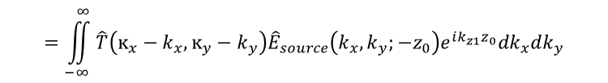
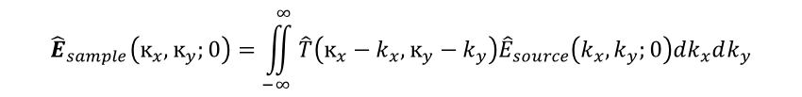
Theoretical background : propagation of near field to far-field
After the interaction of the source field with the sample, the transmitted field is calculated at sample plane:
$$\left.E_{sample}(x,y;0)=T(x,y)E_{source}(x,y;0\right)$$
Where T (x, y) is the transmission function of the sample. The multiplication of T and $E_{source}$ in direct space becomes a convolution in Fourier space and the Fourier spectrum of $E_{sample }$ can be written as :
$${\hat{E}}_{sample}\left(ĸ_{x},ĸ_{y};0\right)=\iint_{−∞}^{∞}{\hat{T}\left(ĸ_{x}−k_{x},{ĸ_{y}−k}_{y}\right){\hat{E}}_{source}\left(k_{x},k_{y};0\right)dk_{x}dk_{y}}$$
$$=\iint_{−∞}^{∞}{\hat{T}\left(ĸ_{x}−k_{x},{ĸ_{y}−k}_{y}\right){\hat{E}}_{source}\left(k_{x},k_{y};−z_{0}\right)e^{ik_{z1}z_{0}}dk_{x}dk_{y}}$$
Where $\hat{T}({k^{′}}_{x},{k^{′}}_{y})$ is the Fourier transformation of T and ${k′}_{i}=ĸ_{i}−k_{i}, i ε \left\{x,y\right\}.$ Here, $k_{x}, k_{y}, and k_{z}$represent spatial frequencies for different coordinates and$ĸ_{x}$, $ĸ_{y}$ and $ĸ_{z}$ represent transverse wavenumber.
Fig.3 :Attenuation of bandwidth of spatial frequencies upon propagation from source (z=-z₀) to sample (z = 0).
Next, we propagate the sample field $E_{sample}$ to the detector plane:
$$E_{detector}\left(x,y;z_{∞}\right)=\iint_{−∞}^{∞}{{\hat{E}}_{sample}\left(ĸ_{x},ĸ_{y};0\right)e^{\left.i[ĸ_{x}x+ĸ_{y}y\right]}e^{iĸ_{z}z_{∞}}dĸ_{x}dĸ_{y}}$$
Because of the propagator exp [i${ ĸ}_{z}z_{∞}]$ only plane wave components which fulfills
$\left|ĸ_{||}\right|≤k_{3}= \frac{ω}{c}n_{3}$, where $ĸ_{||}$ is the transverse wave number and is defined as $ĸ_{||}≤{[ĸ_{x}^{2}+ĸ_{y}^{2}]}^{1/2}$ will reach the detector.
Ref. Novotny, L. Principle of Nano Optics. Cambridge 6, (2006)

Slide 13
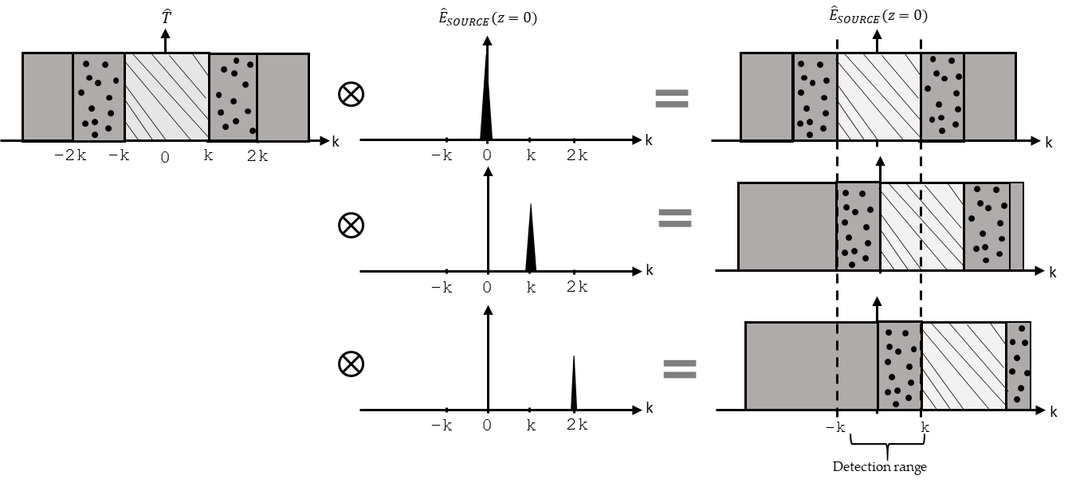

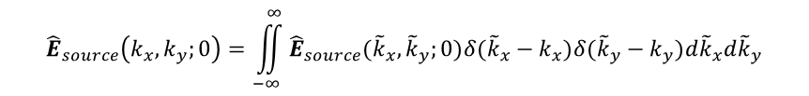


Theoretical background : propagation of near field to far-field
In order to understand the role of evanescent waves we rewrite the spectrum of the source field as a sum over discrete spatial frequencies:
$${\hat{E}}_{source}\left(k_{x},k_{y};0\right)=\iint_{−∞}^{∞}{{\hat{E}}_{source}({\tilde{k}}_{x},{\tilde{k}}_{y};0)δ({\tilde{k}}_{x}−k_{x})δ({\tilde{k}}_{y}−k_{y})d{\tilde{k}}_{x}d{\tilde{k}}_{y}}$$
Source field consisting of a single pair of spatial frequency will shift the transverse wave vector of the sample $k_{||}^{′}$ as:
$$ĸ_{||}=k_{||}±k_{||}^{′}$$
Fig.4 :Convolution of the spatial spectra of sample transmission $\hat{T}$ and source field ${\hat{E}}_{source}$
Using a confined source field with a larger bandwidth of spatial frequencies makes high spatial frequencies of the sample become accessible in the far-field. So, the better the confinement of the source field is, the better the resolution of the sample will be.
The highest spatial frequencies that can be sampled using a specific probe field can be expressed:
$$k_{||,max}^{′}+k_{||,max}=\frac{2πNA}{λ}$$
For a confined source field with a characteristic lateral dimension L, the highest spatial frequencies are on the order of k_{ll, max} ≈ π/L and thus
$k_{||,max}^{′}= \frac{π}{L}+\frac{2πNA}{λ}$;
Ref:- Novotny, L. Principle of Nano Optics. Cambridge 6, (2006)

Slide 14
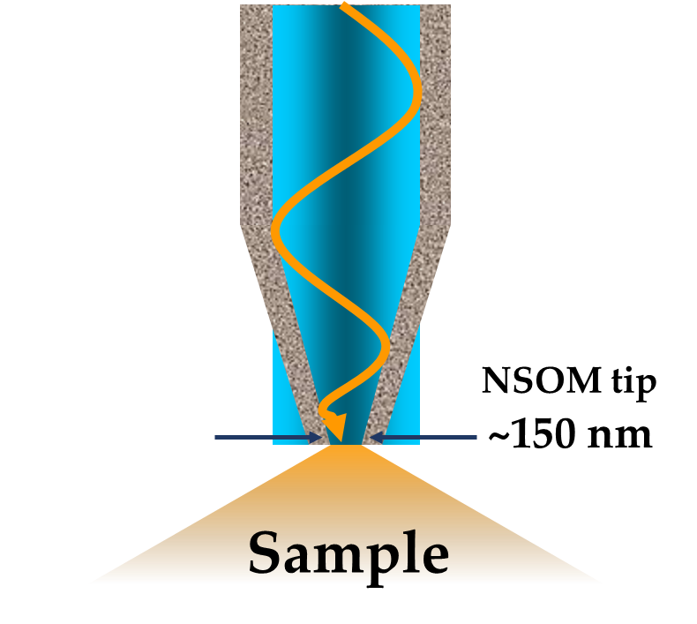
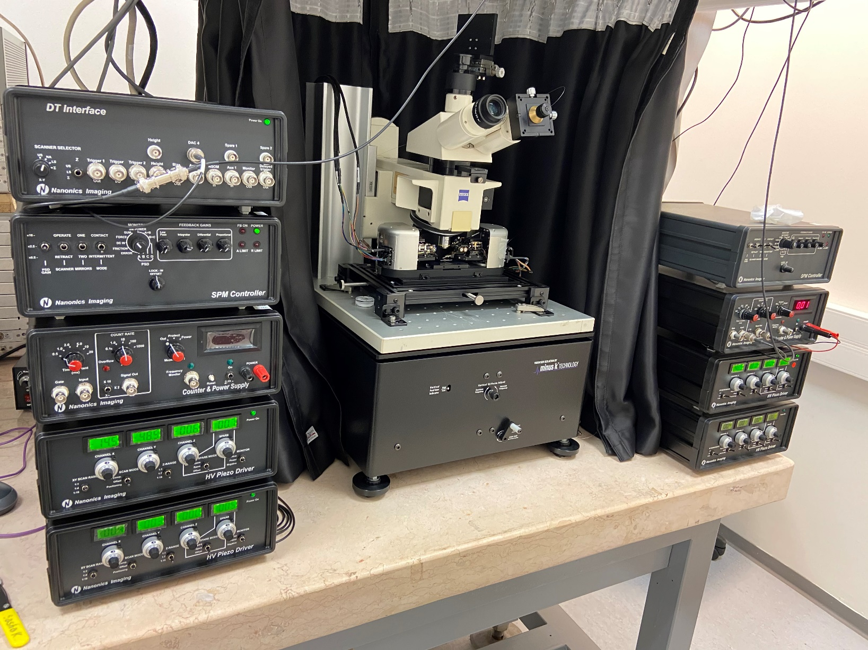
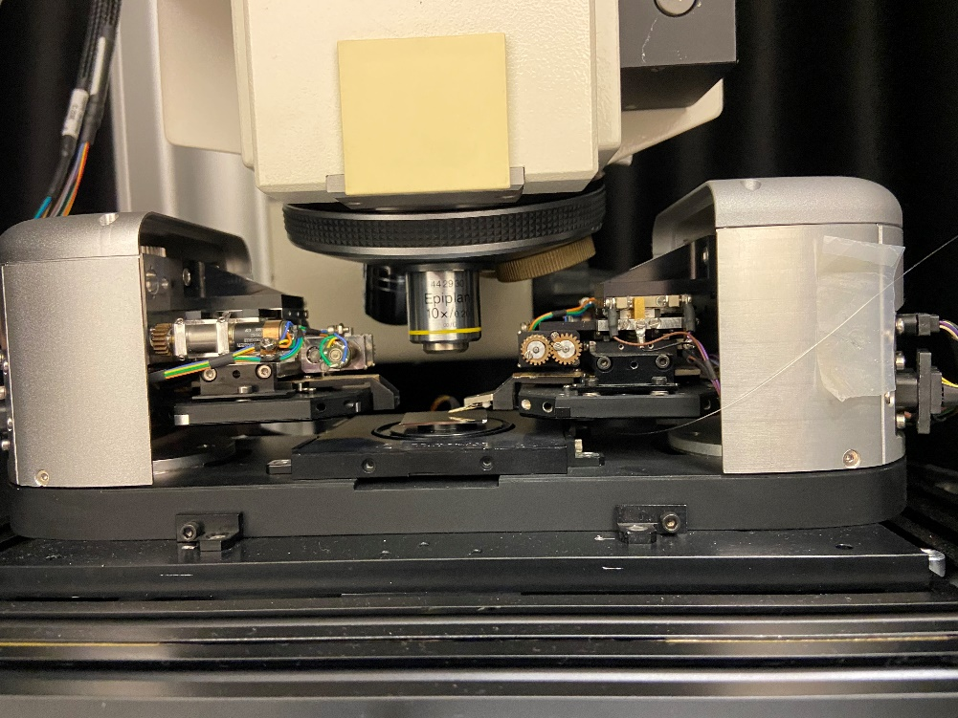
Experimental demonstration: NSOM
Laser =532 nm
SPM controller
Sample
NSOM Probe
Two tower NSOM system
Integration with upright optical microscope

Slide 15
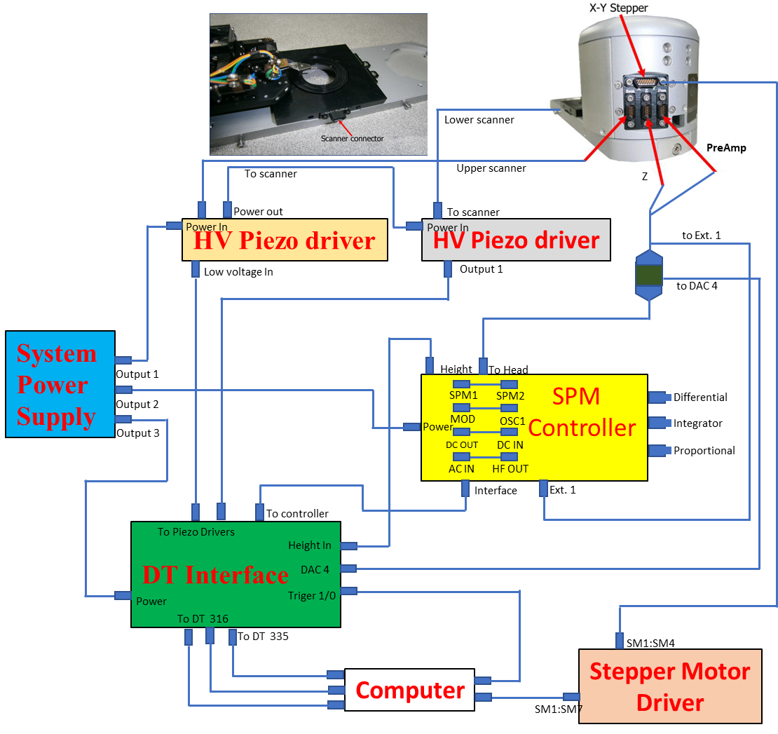
Experimental description: NSOM
MultiView-4000 system which comprises the following components: scanning tower; scanning probe microscopy (SPM) controller; High Voltage (HV) piezo driver; Data Translation (DT) interface; System power supply; Stepper Motor Driver (SMD) and computer
The SPM controller is heart of the system which process the error signal via the on-board Lock-in amplifier and by using the Proportional (P) Integrator (I) and Differential (D) feedback gains.
The two HV Piezo Driver, each for the lower and upper scanner, process the signals from the SPM controller and supplies the high-voltage signals necessary to move the upper scanner on the z-axis.
In addition, it receives the xy low-voltage signals from the DT Interface and converts them to the high-voltage signals needed to perform the xyz scan. The DT interface contains the ADC/DAC that provides an interface between the data translation cards in the main computer and the SPM controller.

Slide 16
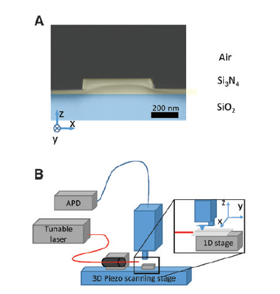
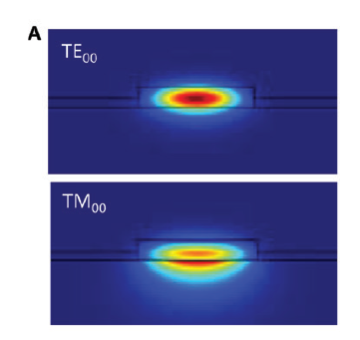
NSOM application : Near-field 3D imaging of nanophotonic waveguide
Fig. 6 : (A) The intensity of the quasi-TE00 mode and quasi-TM00 mode in a 1-μm-wide waveguide at a wavelength of 780 nm.
Fig.5 :(A) Edge-on scanning electron microscope image of a 650- nm-wide Si3N4 waveguide on substrate (false colored). (B) Schematic of the NSOM with 3-D fiber alignment stage for coupling the optical source to the on-chip waveguides.
Ref: Ziegler, Jed I., et al. "3-D near-field imaging of guided modes in nanophotonic waveguides." Nanophotonics 6.5 (2017): 1141-1149.

Slide 17
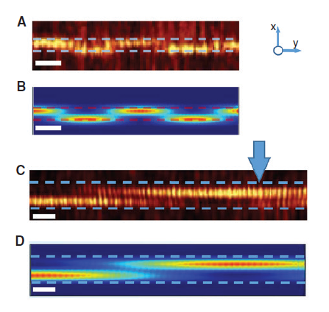
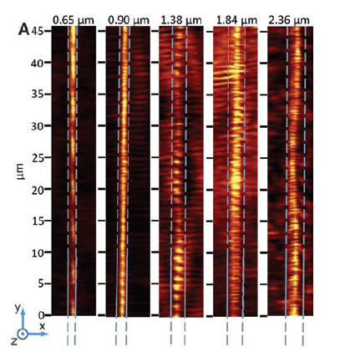
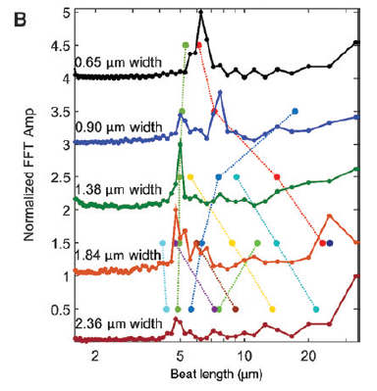
NSOM application : Near-field 3D imaging of nanophotonic waveguide
Fig. 8:(A) NSOM images of a 46-μm region of each fabricated waveguide. Blue lines outline the physical edges of the waveguide, concurrently measured by the NSOM tip. (3 μm scale bar) (B). Waterfall plot of FFTs of near-field intensity taken along each waveguide in (A). Periodic features present, but obscured in (A), show up as peaks in the FFTs. The excitation source is polarized at 45° with respect to the substrate plane for all waveguides. Colored dots and connecting lines indicate the computationally determined beat lengths for the respective waveguide widths.
Fig.7 :(A) An NSOM image of a 0.90-μm-wide waveguide excited with horizontally polarized light and (B) a Comsol calculation of the electric field (square-magnitude) for the same waveguide. (C) NSOM image of a 2.38-μm-wide waveguide excited with horizontally polarized light and (D) a Comsol calculation of the electric field (square magnitude) for the same waveguide. All scale bars are at 2 μm. All dotted lines indicate the outline of the waveguide.
Ref: Ziegler, Jed I., et al. "3-D near-field imaging of guided modes in nanophotonic waveguides." Nanophotonics 6.5 (2017): 1141-1149.

Slide 18
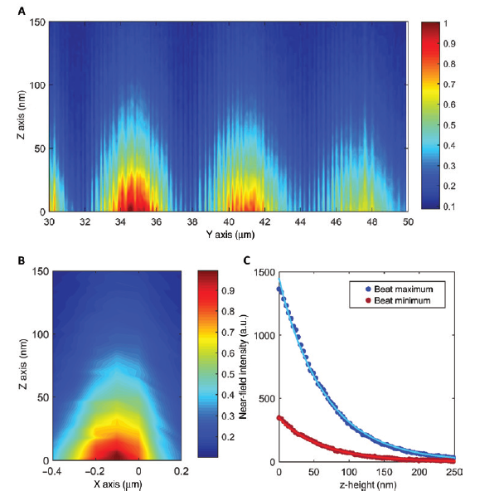
NSOM application : Near-field 3D imaging of nanophotonic waveguide
Figure 9: (A) Longitudinal cross-section, through the y-z plane, of 3-D NSOM scan along a 0.65-μm Si3N4 waveguide. The cross-section is located along the center of the waveguide.
(B) Transverse cross-section, through the x-z plane, of 3-D NSOM scan for a 0.65-μm Si3N4 waveguide. This cross-section is taken at the center of the antinode of a beat. (A) and (B) Intensities are normalized to the maximum of each.
(C) Typical near-field intensity data (points) as a function of height above the waveguide (Z-axis). These example data sets are located near a beat maximum and minimum. Exponential fits (solid lines) agree well. The contrast ratio between the two profiles is ~4.
Ref: Ziegler, Jed I., et al. "3-D near-field imaging of guided modes in nanophotonic waveguides." Nanophotonics 6.5 (2017): 1141-1149.

Slide 19
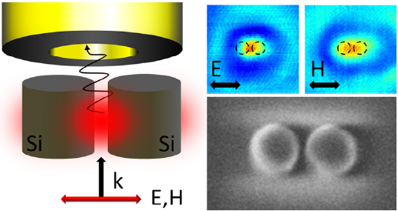
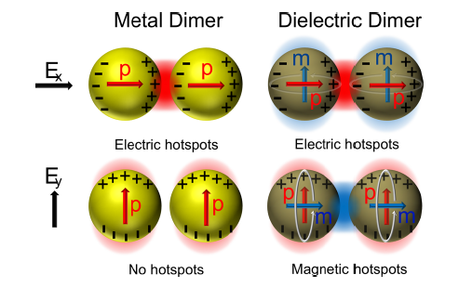
NSOM application : Magnetic and Electric Hotspots with Silicon Nanodimers
Comparison of metallic (plasmonic) and dielectric Nano dimers.
Plasmonic dimers (left) only have electric dipoles that couple under a single polarization while dielectric dimers have both electric dipoles and magnetic dipoles that couple under the orthogonal polarizations.
Compared to metallic nanostructures employed in plasmonics, the near-fields in dielectric nanostructures immediately adjacent to the particles are less intense but can have larger far-field scattering cross sections.
In this study, a nanodimer consisting of two silicon (Si) nanocylinders of diameter 140 nm and height 150 nm placed on a quartz substrate is considered.
Experimentally, gaps of 30, 60, and 120 nm are tested for varying degrees of coupling between the two particles. The system is studied at visible wavelengths for both X- and Y-polarizations of incident light.
As illustrated in Figure, for X-polarized light, the dielectric dimer exhibits coupling of the induced electric dipoles while for Y-polarized light there is coupling between the magnetic dipoles.
Fig.10 : Comparison of metallic (plasmonic) and dielectric Nano dimers
Ref: Reuben M. Bakker, et. al., Nano Letters 2015 15 (3), 2137-2142

Slide 20
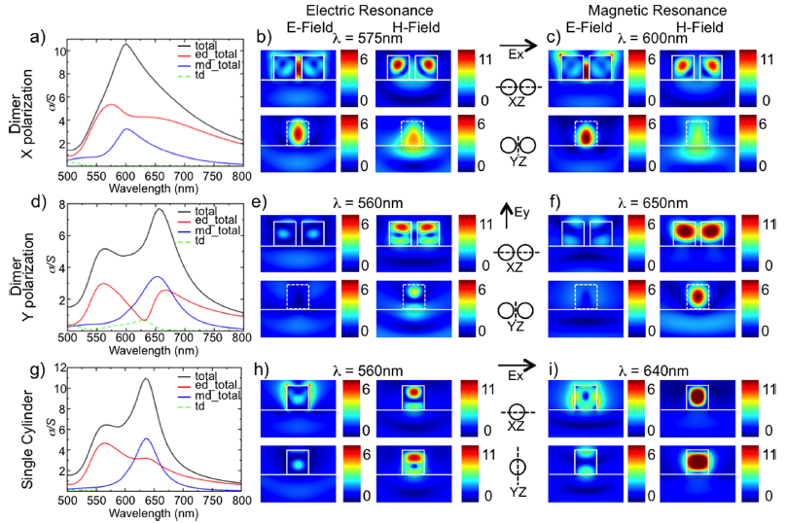
NSOM application : Magnetic and Electric Hotspots with Silicon Nanodimers
Fig.11 :Numerical results for a silicon dimer (a−f) and a single cylinder (g−i) excited by plane wave from the substrate side

Slide 21
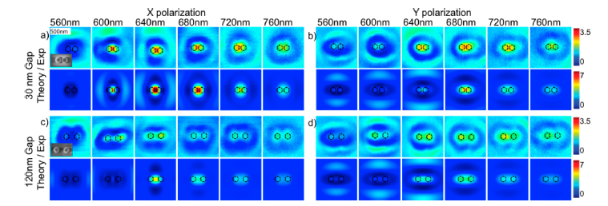
NSOM application : Magnetic and Electric Hotspots with Silicon Nanodimers
The near-field profiles are studied experimentally with a near-field scanning optical microscope (Multiprobe SPM/NSOM,
Nanonics Imaging Ltd.).
The sample is illuminated from the far-field using linearly polarized light, focused to a spot size of approximately 5 μm on the sample.
Fig.12 : Experimental near-field maps of Si nanodimers compared with simulated near-field maps, as a function of wavelength, dimer gap, dimension, and polarization.
Distinct resonance features and evolution as a function of wavelength are observed for the dimer gap and polarization cases
Comparing the NSOM maps obtained for the dimers with 30 and 120 nm gap one can immediately see that for the case of the smaller gap, the NSOM signal reaches larger enhancement for both polarizations. This provides experimental evidence of field localization via electromagnetic coupling of the two silicon nanocylinders.
Ref: Reuben M. Bakker, et. al., Nano Letters 2015 15 (3), 2137-2142

Slide 22
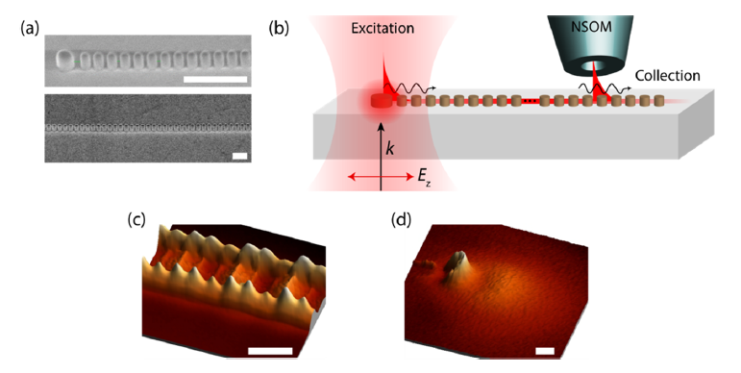
NSOM application: Resonance light guiding in 1-D photonic crystal
An alternative to plasmonic for manipulating light at the subwavelength scale is high-index dielectric nanoparticle based Nanophotonics
For example, silicon with a refractive index of ∼4 offers the opportunity to tune both an electric dipole and magnetic dipole response at visible and NIR wavelengths.
Compared to plasmonics, this system has significantly lower material losses and there are two fundamental dipole resonances (electric and magnetic) to use in system engineering. Resonances from one particle can couple to an adjacent particle in a near lossless manner through dipole−dipole interaction and for multiple nanoparticles, waveguiding occurs.
This work is the first experimental demonstration of subwavelength waveguiding through resonant dielectric nanoparticle chains at visible, 720 nm, (cylindrical nanoparticles with a diameter, D, and height, H, of 150 nm) and NIR, 960 nm, (D and H of 220 nm) wavelengths along a chain of resonant silicon nanoparticles.
Fig.25 :Experimental measurement of waveguiding through chains of silicon nanoparticles. (a) Scanning electron microscope image of the Silicon nanoparticle waveguide for 150 nm case. (b) Measurement setup showing the excitation of the waveguide with linearly polarized light focused on the origin and collection of evanescent fields with an uncoated NSOM tip from different sections of the waveguide. (c) A representative near-field microscopy image of the waveguide mode. This image is taken with a wavelength of 720 nm, 400 μm away from the origin. (d) A representative near-field microscopy image of the end point of the waveguide. This image is taken with a wavelength of 720 nm, 580 μm away from the origin. All scale bars are 500 nm.
Ref:- Arseniy I. Kuznetsov et.all Nano Letters 2017 17 (6), 3458-3464

Slide 23
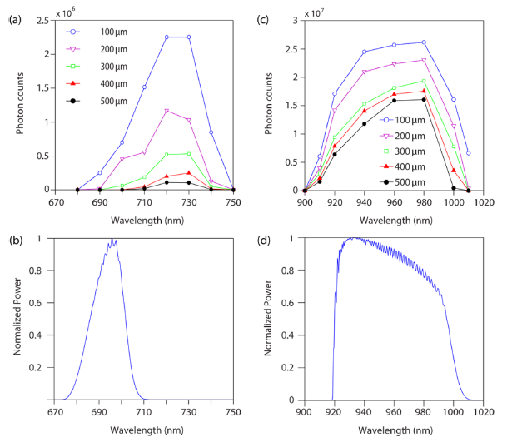
NSOM application: Resonance light guiding in 1-D photonic crystal
Waveguide measurements are compiled as a function of wavelength and distance. The 150 nm nanoparticle waveguide has peak propagation at a wavelength of 720 nm with losses of 34 ± 1.3 dB/mm and a bandwidth of 30 nm. The 220 nm nanoparticle waveguide has peak propagation at a wavelength of 960 nm with losses of 5.5 ± 0.8 dB/mm and a bandwidth of 90 nm. The reduced loss is expected as amorphous silicon has less material loss at 960 nm compared to 720 nm. Moving further into the NIR (such as 1310 and 1550 nm), we expect an optimally designed system to demonstrate even less loss.
The experimental propagation is directly compared with full numerical FDTD simulations
The simulations compare well with the experimental data except for a wavelength shift for the visible case. This shift is likely due to a difference in the material parameters of the fabricated sample from the deposited films used in the ellipsometry measurements
Fig.26 :Near-field scanning optical microscopy transmission measurements as a function of wavelength for visible (a) and NIR (c) waveguides compared with simulations for visible (b) and NIR (d). (a,c) Photon counts taken over multiple unit cells of nanoparticles, plotted as a function of excitation wavelength for distances of 100, 200, 300, 400, and 500 μm away from the waveguide origin. (b,d) Simulated transmission spectrum for the corresponding geometry
Ref:- Arseniy I. Kuznetsov et.all Nano Letters 2017 17 (6), 3458-3464

Slide 24
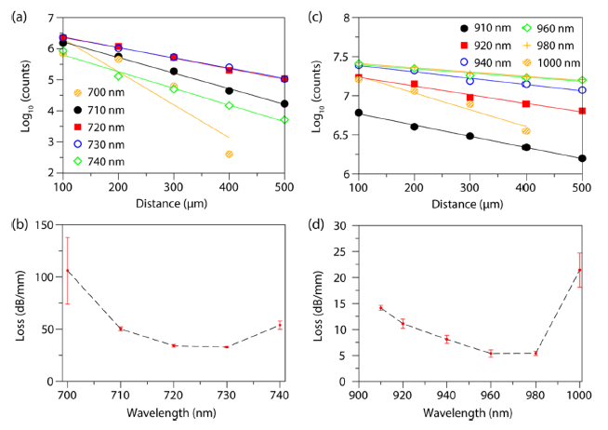
NSOM application: Resonance light guiding in 1-D photonic crystal
Fig.27 : Experimental measurements illustrating propagation loss for visible (a,b) and NIR (c,d) waveguides. The experimental results from Fig.26 are plotted to determine loss as a function of wavelength. (a,c) Photon counts are plotted in semilog format as a function of distance from the origin for the different propagating wavelengths. (b,d) Experimental loss as a function of wavelength for the visible and NIR nanoparticle waveguides. Light at 720 nm shows a propagation loss of 34 ± 1.3 dB/mm. Light at 960 nm shows a propagation loss of 5.5 ± 0.8 dB/mm. The error bars originate from the linear regression of the data.
Ref:- Arseniy I. Kuznetsov et.all Nano Letters 2017 17 (6), 3458-3464

Slide 25
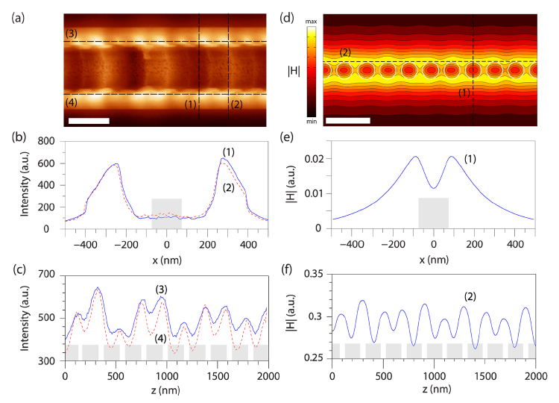
NSOM application: Resonance light guiding in 1-D photonic crystal
Conclusion:
The dominant, resonant mode of the visible wavelength chain (taken at 720 nm) is illustrated in Figure 28 via experimental (Figure 28a−c) and numerical (Figure 28d−f) field maps with associated cross section plots
This work demonstrates subwavelength confined waveguiding at distances over 500 μm with visible and NIR light. This most fundamental property can be expanded to create a new class of devices, offering control of light on the subwavelength scale without the high losses associated with metal-based nanophotonics and more compact than traditional integrated waveguides.
High-field enhancement at the resonance wavelength and slow-light behavior can be taken advantage of for on-chip sensing and laser devices
Fig.28 :Waveguide field profiles for the 150 nm silicon nanoparticle chain at 720 nm wavelength. (a−c) Experimental NSOM data illustrating an XY mapping of 10 unit cells a distance of 400 μm away from the line origin showing an NSOM signal intensity map (a) along with cross sections orthogonal (b) and parallel (c) to the chain as marked on the map. (d−f) Numerical simulation data of 10 unit cells showing H field modulus map (d) along with cross sections orthogonal (e) and parallel (f) to the chain as marked on the field map. The fields are taken 20 nm above the structures. The scale bars in (a,d) are 400 nm and the position of the particles indicated in gray in (b,c) and (d,e).
Ref:- Arseniy I. Kuznetsov et.all Nano Letters 2017 17 (6), 3458-3464

Slide 26
Conclusion: NSOM Analysis and Application
The final image produced by NSOM can be used to analyze
Change in index of refraction
Change in reflectivity, Polarization and transparency
Magnetic properties, which can change its optical properties
Stress at certain point of the sample that changes its optical properties
Fluorescent molecules
Molecules excited through a Raman shift or other effects
Application
In Nanotechnology research
In Nano-photonics and Nano-optics
Life science and material research-optical detection of the most miniscule surface
Single molecule detection is easily achievable
Dynamic properties can also be studied at a sub wavelength scale.

Slide 27
NSOM limitations
Practically zero working distance and small depth of field.
Extremely long scan times for high resolution images or large specimen areas.
Very low light through such a tiny aperture.
Only features at surface of specimens can be studied.
Fiber optic probes are somewhat problematic for imaging soft materials due to their high spring constants, especially in shear-force mode.

Slide 28


